Slide 1
Do language models have coherent mental models of everyday things?
Natural language processing · Master’s Degree in Physics of data
Gloria Isotton - 2072705
Kostas Panagiotakis - 2081260
May 2024

Slide 2
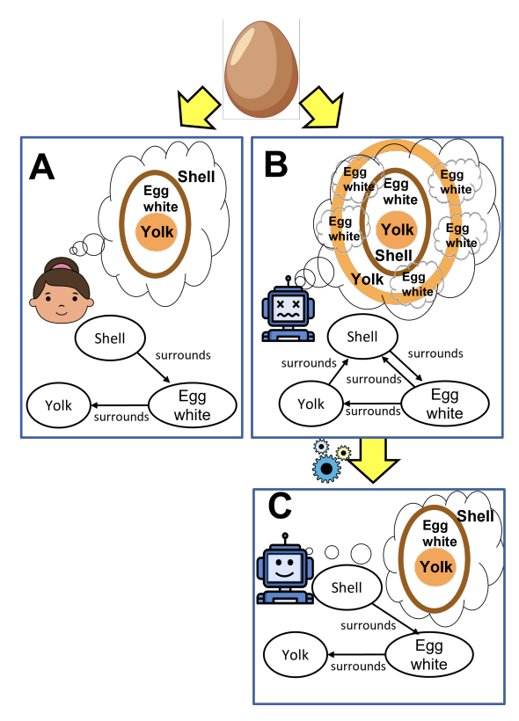
Introduction
People effortlessly understand the parts and relationships of everyday objects. The study aims to assess if language models (LMs) possess similar coherent understandings.
Dataset Description: Consists of 100 everyday objects. Includes parts and relationships expressed as 11,720 true/false questions.
Proposed Solution: Integrate a constraint satisfaction layer onto LM's raw predictions to enhance coherence while applying commonsense constraints.

Slide 3
Do LMs possess coherent internal representations?
Psychologists suggest:
humans develop mental models of the world to base decisions on (Ha and Schmidhuber, 2018; Jonassen and Henning, 1996).
Infants exhibit understanding of object properties before language comprehension (Hespos and Spelke, 2004).
Investigating if language models (LMs) possess coherent internal representations akin to human mental models, focusing on everyday objects. Lack of coherent mental models in LMs leads to impractical reasoning (Andreas, 2022).
State-of-the-art LMs like GPT-3 and Macaw perform poorly in answering relationship queries between object parts.
Notes:
Drawing loosely on this idea, but without making any claims about how LMs reason internally, we investigate if pre-trained language models show evidence of coherent internal representations of everyday things, analogous to human mental models, via probing. They contradict often

Slide 4
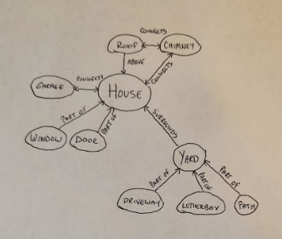
Building and Evaluating Parts Mental Models
"Parts mental model", (pmm), for everyday objects: a focused subset of a complete mental model represented as a directed graph. Parts mental models consist of nodes representing parts and edges indicating relationships between them, including:
spatial orientation
connectivity
functional dependency
Dataset creation involves human annotators constructing pmm based on predefined parts and relationship vocabulary.
The dataset as an ensemble is known as ParRoT.
https://www.dropbox.com/sh/tv2hc6pmsbr25l3/AAAXZKvfkfyx6SAkqjolhS0ra?dl=0&e=1&file_subpath=%2FParRoT_MM_sketches&preview=ParRoT_MM_sketches.zip

Slide 5
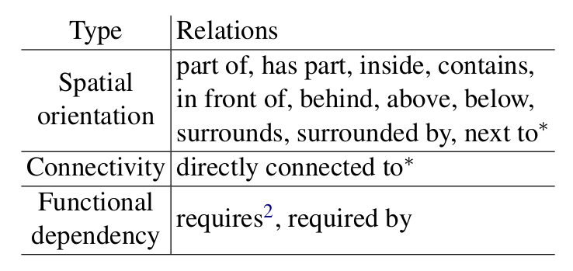
Parts mental models
The authors considered 14 different relationships between parts of objects:
11 relations come from prior research on spatial relations (Renz, 2002; Gunning et al., 2010).
3 additional relations describe connectivity and functional dependency.

Slide 6
A closer look: the Task
Define the objective as constructing a parts mental model for everyday things.
Input Specifications: Include the everyday thing, parts list, and a relation vocabulary comprising 14 relations.
Output Specifications: Require a list of tuples (x, r, y) where relation r holds between parts x and y.
Evaluation Criteria: Specify the criteria for evaluating LM-generated parts mental models, including accuracy of LM-generated parts mental models compared to gold-standard models in our dataset and adherence to commonsense constraints such as the inverse relation between 'above' and 'below', ensuring predictions align with established patterns.

Slide 7
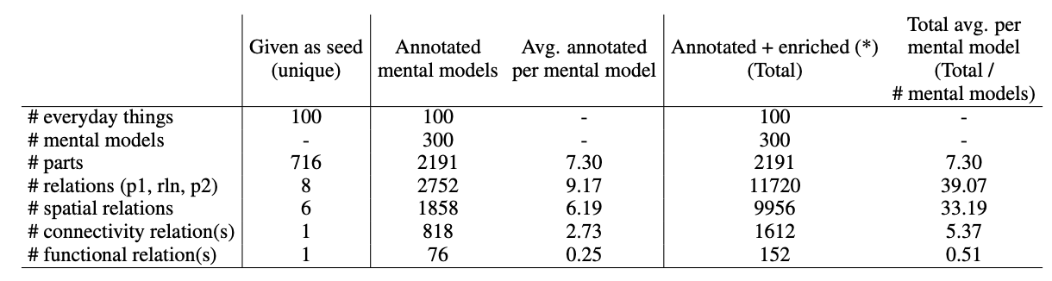
Enriched annotations
The model in the study automatically infers new connections (positive & negative) between everyday objects, using four types of constraints (symmetric, asymmetric, inverse, and transitive)
Inferred relationships can be positive (e.g., "A above B" implies "B below A") or negative (e.g., "A above B" implies "B NOT above A").
This adds over 11,700 relationships to the knowledge base.

Slide 8
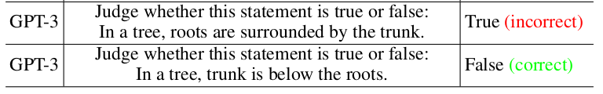


ParRoT-Con: Improving LM
Step 1: Probing a Pre-trained Language Model
Query:
part 1
relation
part 2
LM
GPT 3/ Macaw :
Answer:
{True;False}

Slide 9
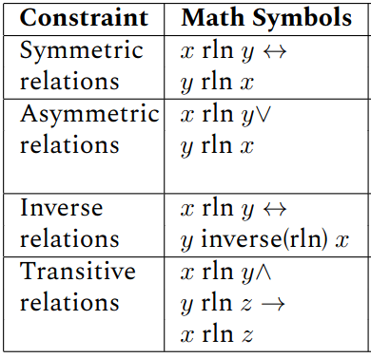
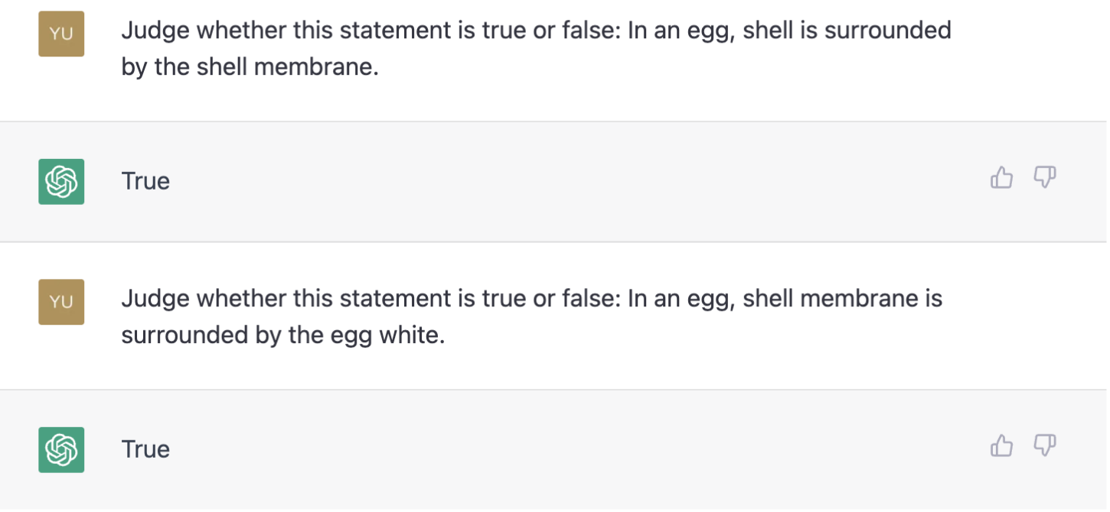
ParRoT-Con: Improving LM
Step 2: Constraint Reasoning
Many inconsistencies have been reported by considering the following hard constraints:
ChatGPT: violation of Asymmetric relation

Slide 10
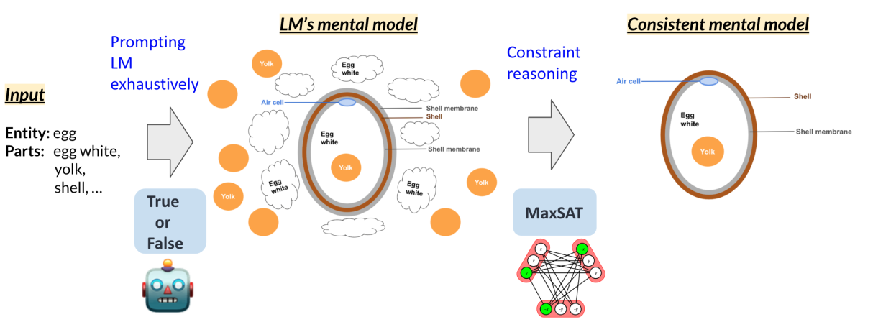
Step 2: Constraint Reasoning
Constraint reasoning refines predictions from the LM using weighted MaxSAT Solver;
it tries different combinations of true/false values for the relation tuples to fulfill:
Soft Clauses (preferences): preserve the model’s raw answers;
Hard Clauses (mandatory): minimize constraint violations;

Slide 11

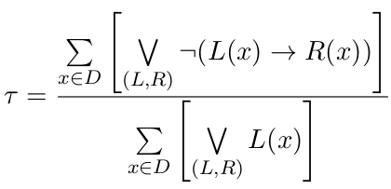

Results and Analysis
Evaluation of parts mental models produced by the two LMs:
accuracy True/False accuracy compared to the 11.7K gold relation tuples present in ParRoT.
Consistency measure inconsistency across the 4 types of constraints:
?

Slide 12
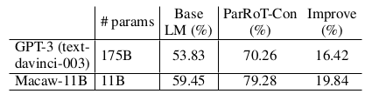
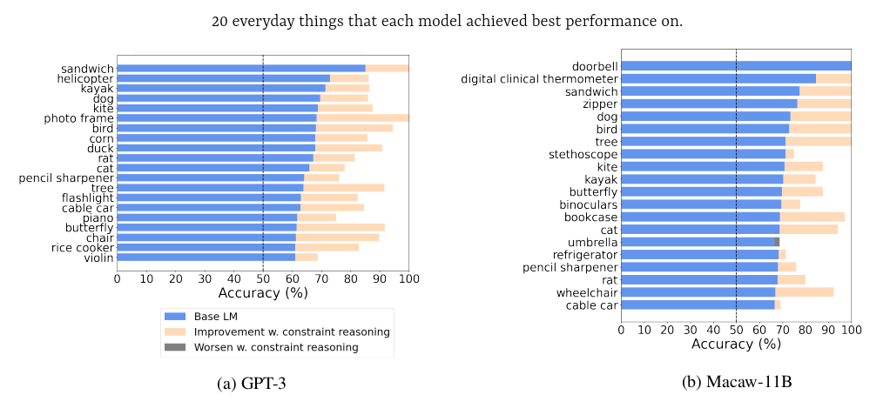
Accuracy results
Average accuracy of 54-59%, barely better than the majority class baseline at 59% and random chance at 50%.

Slide 13
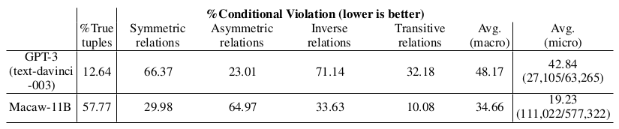
Consistency results
Base LM
19-43% conditional violation on average;
GPT-3 struggles with symmetric and inverse relations consistency;
Macaw-11B struggles with asymmetric relations;
ParRoT-Con
Produces perfectly consistent mental models for all LMs with respect to the imposed constraints i.e. 0 % conditional violation for all columns in table.

Slide 14
Conclusions
The authors were able to:
Built a Benchmark: dataset, ParRoT. This dataset includes detailed information about 100 common things, outlining over 2,000 parts and the relationships between them (more than 11,700 relationships in total).
Exposed LM Weaknesses: Using ParRoT, the authors showed that current LMs generally lack strong mental models of everyday objects, violating basic common sense constraints of everyday things;
Introduced ParRoT-Con: develop a method, ParRoT-Con, to solve the inconsistency problem, which has proven to improve both accuracy (up to 20% improvement) and consistency.

